Slide 1


Course Code: CSE-1122
Course Name: Computer Programming I Lab
Title: STUDENT BOX

Slide 2
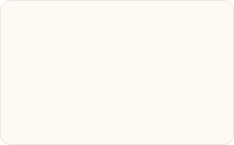
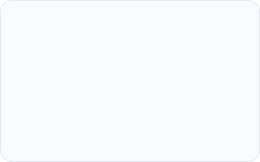




Presented By
Raisul Islam Rakib
Mohammad Ferdous
Mohammad Numan
Abrar Siam
ID: C261002
ID: C261006
ID: C261008
ID: C261009
Presented To
Department of CSE
MD.Tanvir Ahammed Shawon
Lecturer
International Islamic University Chittagong

Slide 3
Table of Contents
Serial No. | Contents
1 | Introduction
2 | Project Objectives
3 | Project Description
4 | Features
5 | Functional Requirements
6 | Input Validation
7 | System Flow
8 | Tools & Technologies
9 | Data Structure
10 | Core System Modules
11 | Sample Output
12 | Advantages
13 | Limitations
14 | Future Improvements
15 | Conclusion

Slide 4
1. Introduction
1. Introduction
Student Box is a console-based Student Management System developed using the C programming language. The project helps maintain student records efficiently. It allows users to add, display, search, update, delete student information and calculate student CGPA and academic results.
The system is menu-driven and designed to provide an easy and user-friendly interface

Slide 5

.
2. Project Objectives
Store student information.
Search student by Student ID.
Update student information.
Delete student records.
Display all students.
Calculate and display student CGPA.
Practice File Handling, Structures, Functions and Validation in C Programming

Slide 6
3. Project Description
Student Box is developed for maintaining student records of IIUC students. Every student has a unique Student ID.
The project validates:
Student ID
Department
Semester
CGPA
to ensure correct data entry.
The program is completely menu-driven.

Slide 7

4. Features
✅ Add Student Information
✅ Display All Students
✅ Search Student by Student ID
✅ Update Student Information
✅ Delete Student Information
✅ Calculate & Display Student Result/CGPA
✅ Input Validation
✅ User Friendly Men

Slide 8
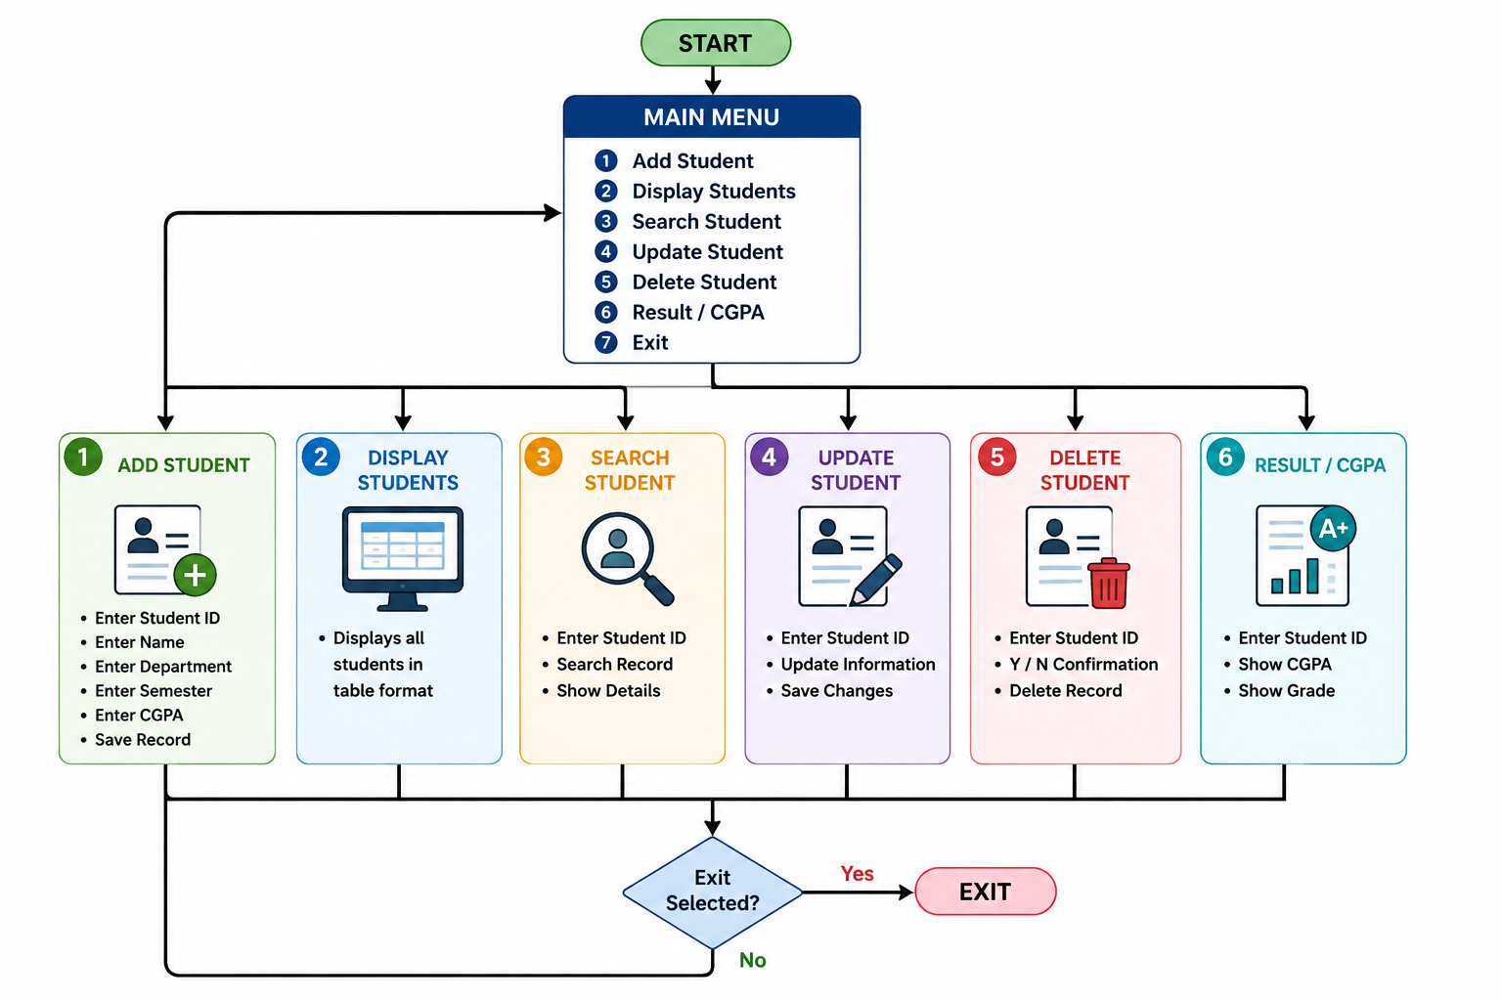
5. Functional Requirements
┌───────────────┐
│ START │
└───────┬───────┘
│
▼
┌─────────────────────────┐
│ MAIN MENU │
│ 1. Add Student │
│ 2. Display Students │
│ 3. Search Student │
│ 4. Update Student │
│ 5. Delete Student │
│ 6. Result / CGPA │
│ 7. Exit │
└──────────┬──────────────┘
│
┌────────────┼─────────────┐
│ │ │
▼ ▼ ▼
┌────────────────┐ ┌──────────────────┐ ┌─────────────────┐
│ Add Student │ │ Display Students │ │ Search Student │
├────────────────┤ ├──────────────────┤ ├─────────────────┤
│ Enter ID │ │ Show Student │ │ Enter Student ID│
│ Enter Name │ │ List in Table │ │ Search Record │
│ Department │ │ │ │ Show Details │
│ Semester │ └─────────┬────────┘ └────────┬────────┘
│ CGPA │ │ │
└────────┬───────┘ │ │
│ │ │
└──────────────┬────┴──────────────┐
▼ ▼
┌──────────────────┐ ┌──────────────────┐
│ Update Student │ │ Delete Student │
├──────────────────┤ ├──────────────────┤
│ Enter Student ID │ │ Enter Student ID │
│ Update Data │ │ Y / N Confirm │
│ Save Changes │ │ Delete Record │
└────────┬─────────┘ └────────┬─────────┘
│ │
└──────────┬───────────┘
▼
┌────────────────────────┐
│ Result / CGPA │
├────────────────────────┤
│ Enter Student ID │
│ Show CGPA & Grade │
└──────────┬─────────────┘
│
▼
┌──────────────────┐
│ Exit Selected ? │
└───────┬──────────┘
│
Yes ──────┴──────► END
│
No
│
▼
MAIN MENU

Slide 9
6. Input Validation
Field Name | Validation Requirement | Example / Rule
Student ID | Student ID must be a unique alphanumeric string. | C261006,E261008,s005
Name | Supports alphanumeric characters & spaces | MD Ferdous 01
Department | Must contain alphabetic letters (Not numbers only) | CSE, EEE
Semester | Integer numbers within range 1 to 12 only | Range: 1 - 12
CGPA | Floating point numbers within 0.00 to 4.00 | Range: 0.00 - 4.00
Delete Action | Requires confirmation character prompt | 'Yes' or 'No'

Slide 10
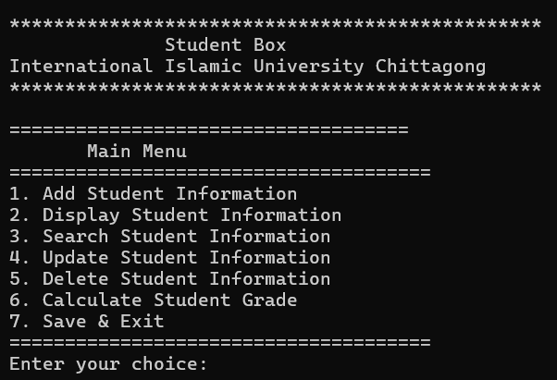
7. System Flow/Program Output
Start
↓
Main Menu
↓
Add Student
↓
Display Student
↓
↓
Search Student
↓
Update Student
↓
Delete Student
↓
Calculate Result
↓
Exit

Slide 11
8. Tools & Technologies
🛠️ Technology | Details
💻 Programming Language | C
🖥️ Compiler | Code::Blocks, Dev-C++, GCC
🪟 Operating System | Windows

Slide 12
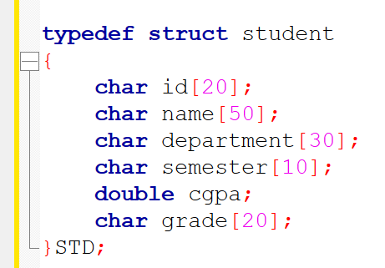
9. Data Structure Used
Student
┌─────────┐
│ ID │
│ Name │
│ Department │
│ Semester │
│ CGPA │
└────────┘

Slide 13
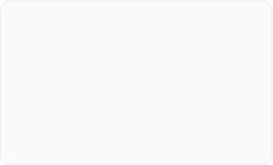
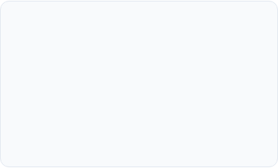
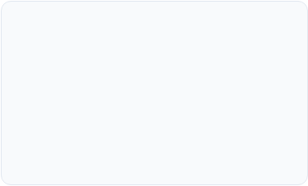



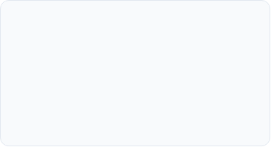
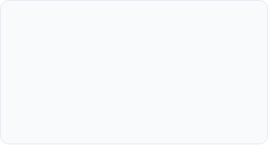
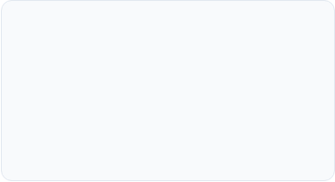


10. Core System Modules
1. Add Student
2. Display All
3. Search Student
Captures student ID, Name, Department, Semester, and CGPA with strict validation logic.
Renders all stored student records in a structured, clean, and aligned tabular layout.
Fast record retrieval by searching unique IIUC Student ID with case-insensitive matching.
4. Update Info
5. Delete Record
6. CGPA / Result
Modifies existing student details dynamically while upholding validation rules.
Removes student records safely after explicit user confirmation (Y/N prompt).
Computes academic standing and displays letter grades based on IIUC CGPA criteria.

Slide 14
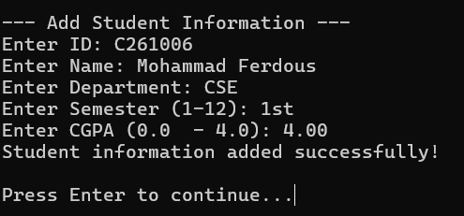
11. Sample Output
[Main Menu SS]
[Add Student SS]

Slide 15
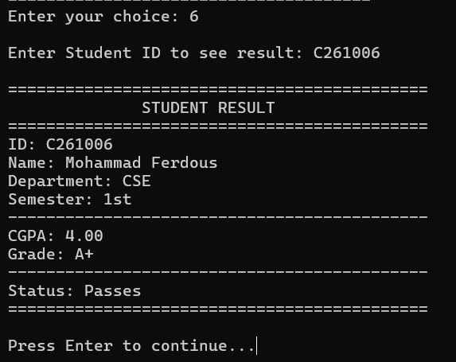
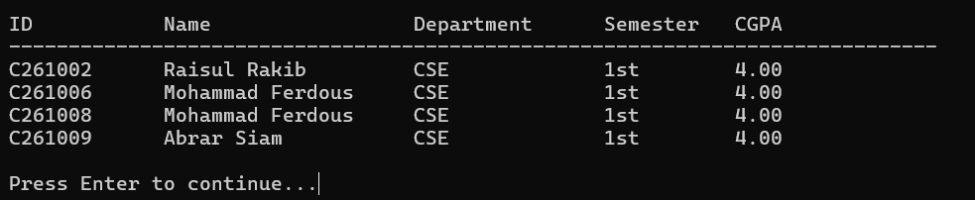
[Display List SS]
[Result/CGPA SS]

Slide 16
12. Advantages
Icon | Advantage | Description
🖱️ | Easy to Use | Simple and user-friendly interface.
🔍 | Fast Searching | Quickly search students using Student ID.
✅ | Accurate Validation | Ensures valid Student ID, Department, Semester, and CGPA.
🛡️ | Prevents Invalid Input | Rejects incorrect or invalid user input.
💻 | Simple Interface | Console-based interface that is easy to understand.
🎓 | Useful for Academic Learning | Demonstrates C programming concepts such as structures, functions, arrays, and validation.
🔧 | Easy to Maintain | Modular code makes updates and maintenance easier.

Slide 17
13. Limitations
Limitation | Description
Console-Based Application | The system operates only through the command-line interface.
Maximum Student Limit | The application can handle only a limited number of student records.
No Login System | User authentication and role-based access are not implemented.
No Database Integration | Data is not stored in a database; it is kept temporarily or in files only.
No Graphical User Interface (GUI) | The system does not provide a visual interface for users.

Slide 18
14: Future Scope
Feature | Icon | Description
🖥️ GUI Version | 🖥️ | Develop a user-friendly graphical interface.
🗄️ Database Integration (MySQL) | 🗄️ | Store and manage student data securely in a database.
🔐 Login Authentication | 🔐 | Add secure user login and access control.
📅 Attendance Management | 📅 | Record and manage student attendance efficiently.
📊 Result Management | 📊 | Generate and manage student results automatically.
☁️ Cloud/File Storage | ☁️ | Store records securely with backup support.
📄 PDF Report Generation | 📄 | Generate printable reports in PDF format.
🌐 Online Student Portal | 🌐 | Enable students to access information online.

Slide 19
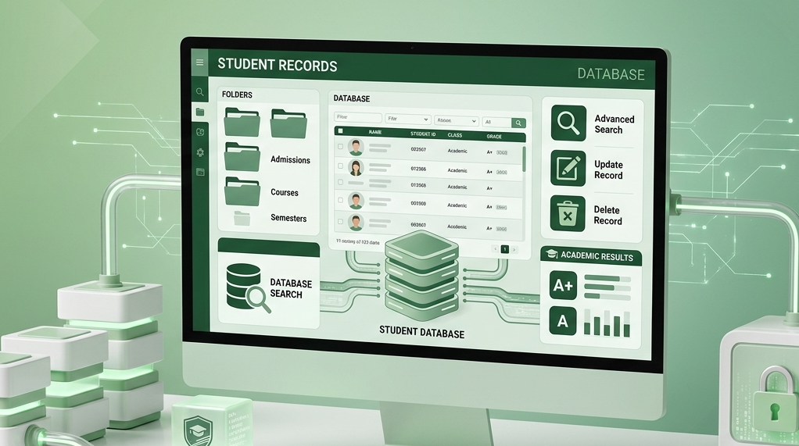
15. Conclusion
Student Box is a simple and efficient Student Management System developed using the C programming language. The project demonstrates the practical use of structures, functions, arrays, loops, conditional statements, and input validation to manage student information effectively. It is suitable as an academic project for learning the fundamentals of C programming while solving a real-world record management problem.

Slide 20

Questions & Answers Session

